Slide 1
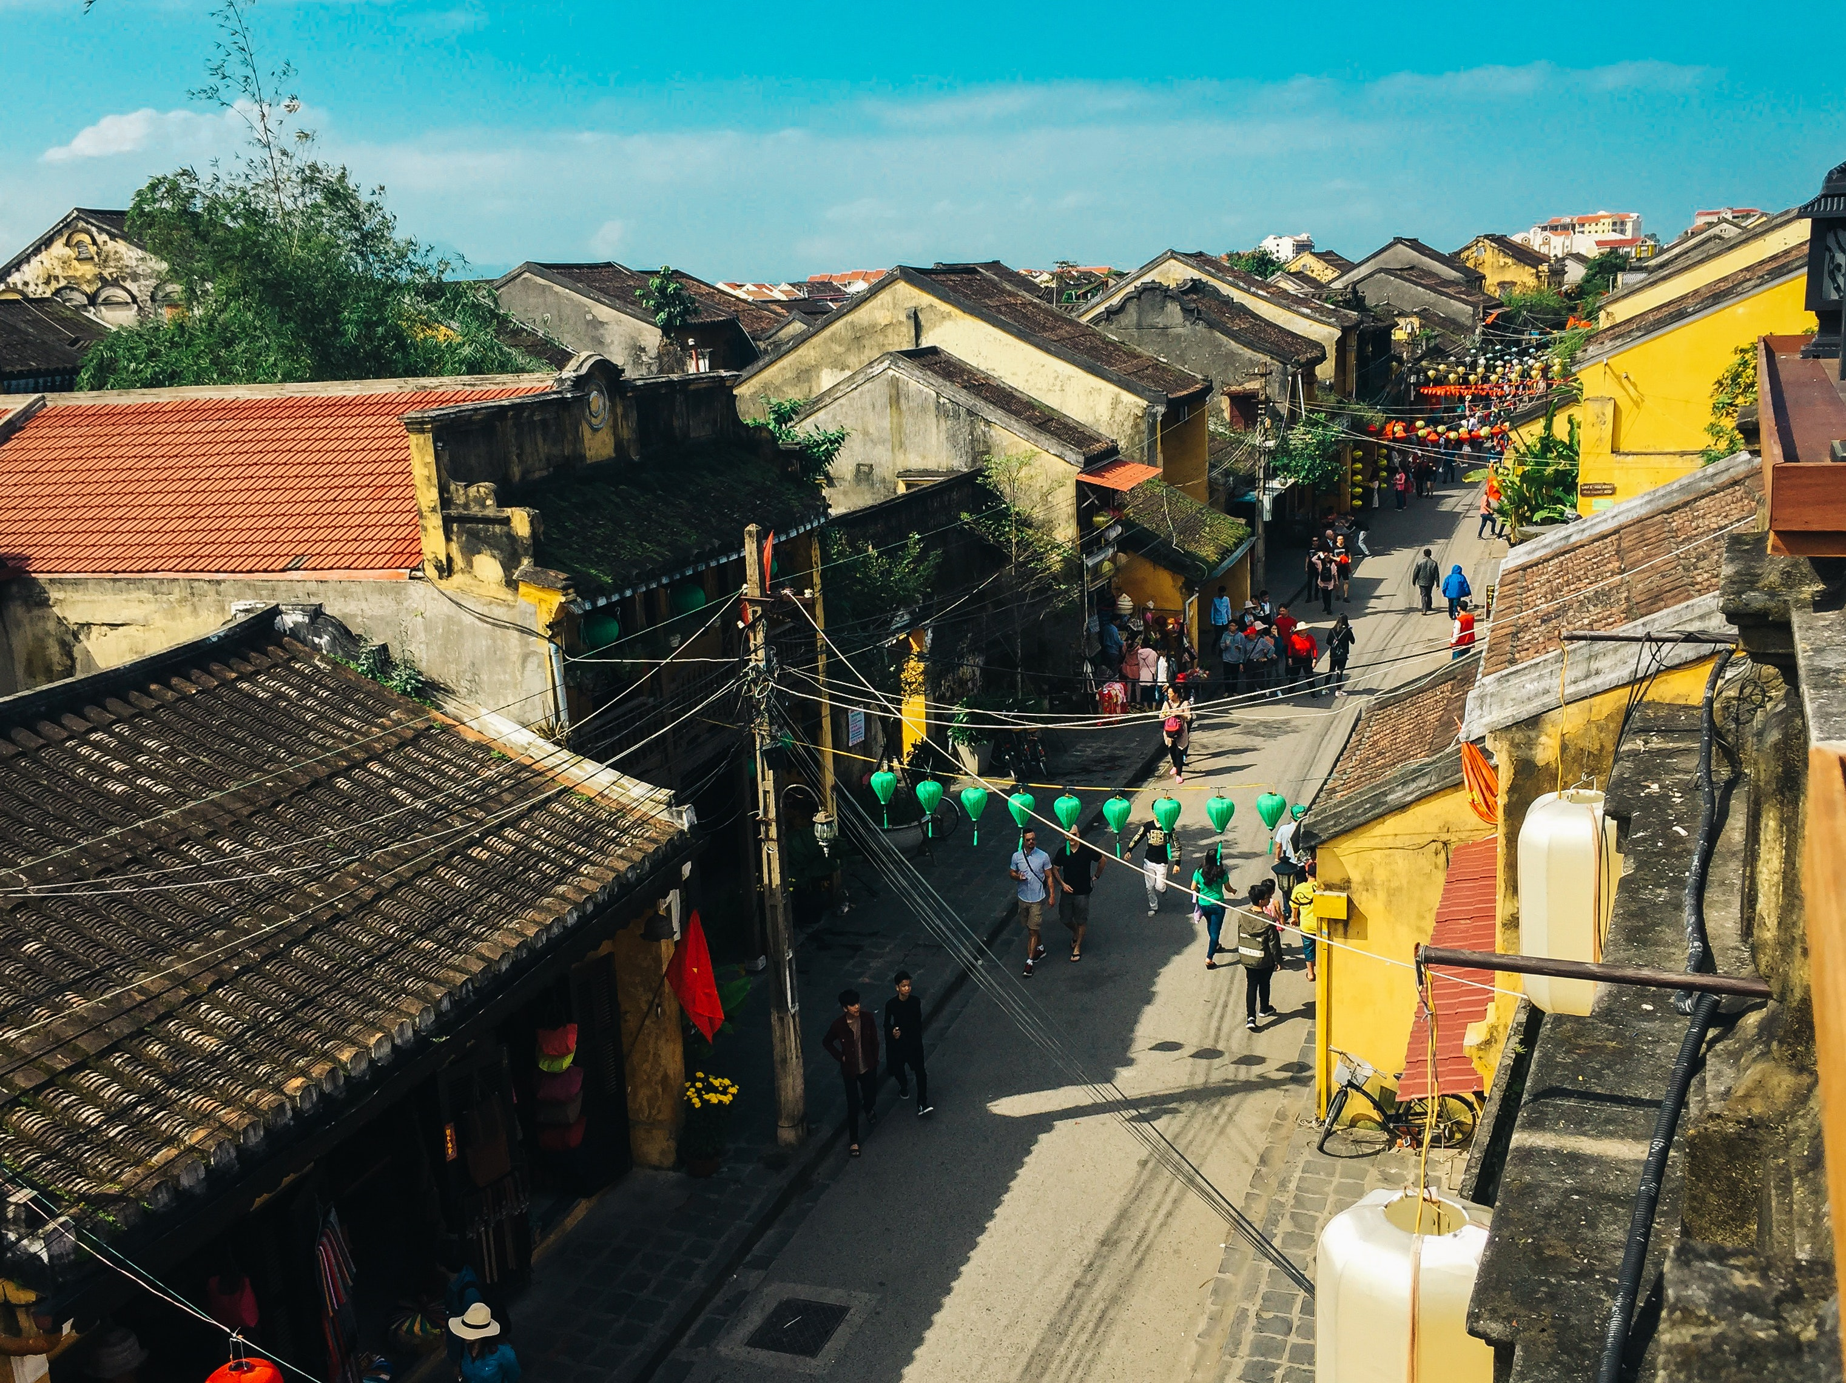
Smart Villages
Final Presentation Technical Writing | August 2018

Slide 2

About
This project report deals with study and development of village as a smart village. We define smart village as bundle of services of which are delivered to its residence and businesses in an effective and efficient manner. “ Smart Village” is that modern energy access acts as a catalyst for development in education , health, security, productive enterprise, environment that in turns support further improvement in energy access. In this report we focuses on improved resource use efficiency, local self-governance, access to assure basic amenities and responsible individual and community behaviour to build happy society. We making smart village by taking smart decisions using smart technologies and services.

Slide 3
70%
India’s population lives in villages
Approx. 6,38,588 Villages
676 Districts
“The Soul of India lives in its village”

Slide 4





The Definition
S
M
A
R
T
Social, skilled and simple
Zero tolerance for caste and creed and no discrimination on gender and religion. Skilled simple living and high thinking.
Moral, methodical and modern
Moral values of Mahatma Gandhi and Swami Vivekananda using modern (latest ) methods.
Aware, adaptive and adjusting
Awareness about global social and economic issues adaptive and adjusting the fast changing environment.
Responsive and ready
Ready to generate all resources for self -sufficiency and self-governance. Responsive for co-operative movements and collective wisdom
Techno-savvy and transparent
Technosavy for IT and transparent mobile usage harmonic relations.

Slide 5




Aims
Maintain Identity, Culture and Heritage
Resources, Services and Schemes
Access to all basic amenities
Plans for development based on People, Assets and Service Centric information and tracks its progress.
Better Employment opportunities and more support to Micro enterprises.
Access to safe drinking water, Toilets and health facilities.

Slide 6

Areas of Interest
There are micro-industries like Pottery, Manufacturing of Khadi, Sari, Churi, Craft work like Brass, Mojri, Silverware, Leather, Puppets etc which can be harnessed and centralised institutions can be developed for them. This will also help in boosting tourism, but it should be controlled and strictly monitored. It needs quality workshops and training for the villagers along with a creation of suitable infrastructure. The scale and requirement of these villages are just fit for trying new strategies like energy production through solar, micro-wind turbines, net metring, rainwater recharging and harvesting, geothermal cooling etc. It will set up model smart villages and will help us in converting our existing cities into smart zones.
Micro industries

Slide 7

SMART BUILDINGS
Security cameras, fire safety electricity management and to prevent burglary.
Remote Supervision and monitoring in open fields and barns. Satellite data for farming activities
Sensors for forecasting weather, monitor health , water level in dams

Slide 8
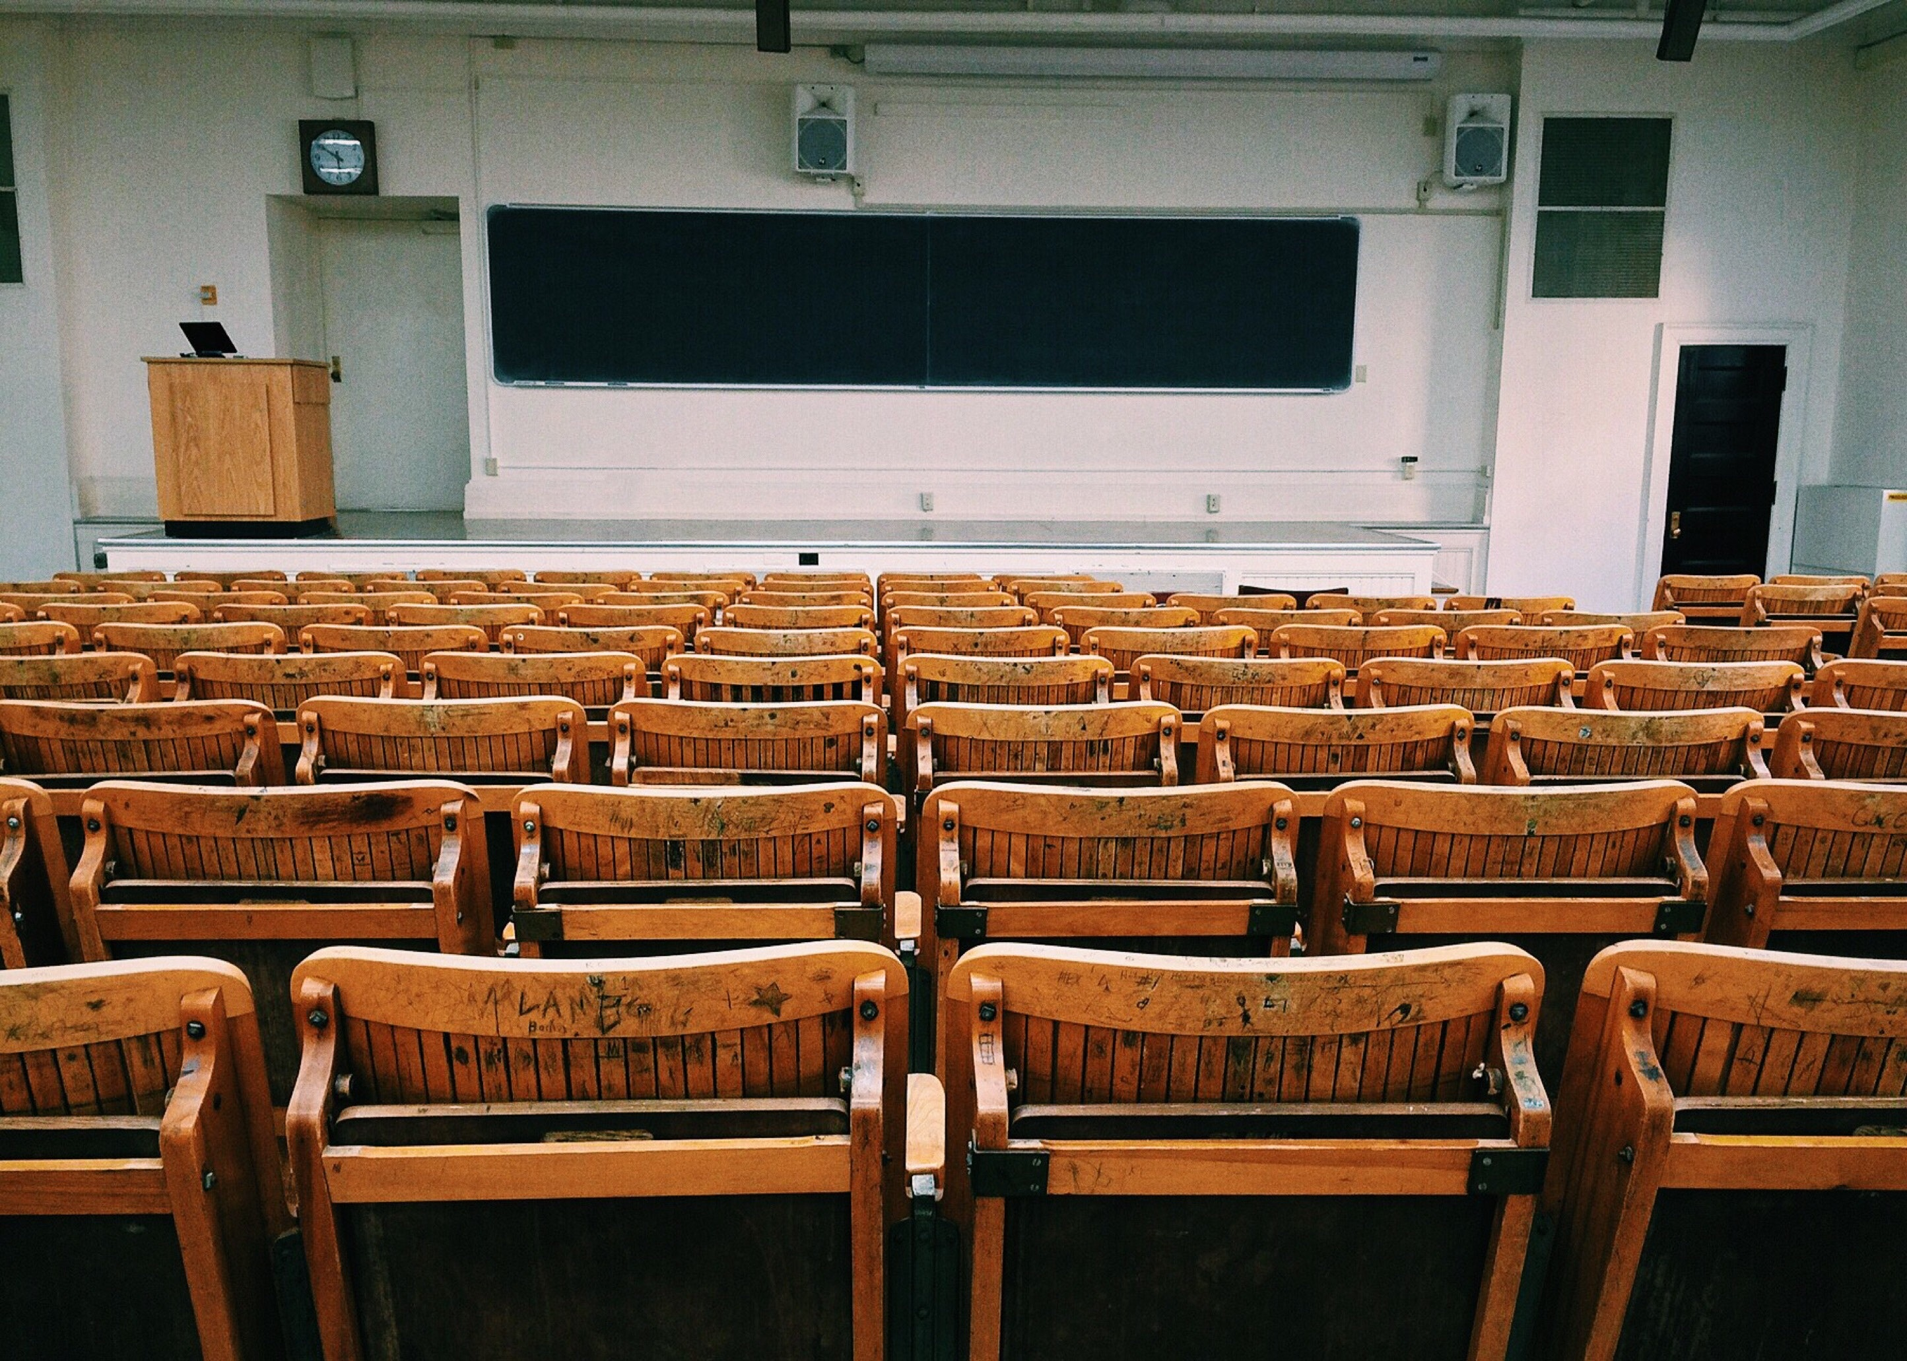
Education - Interactive learning
Emphasize one of the main benefit
71% of the rural population is literate while the other are still illiterate, the fact is rural population is unaware of its importance. This is where we are actually lacking. Among persons of age 14-29 years, nearly 18 per cent in rural areas and 49 per cent in urban areas were able to operate a computer, in today's world where computer literacy is of highest priority only 18% of our rural population is aware about operating a computer.

Slide 9

Education For All.

Slide 10

Challenges
The problem of caste based discrimination still exists. There are people who still practice Untouchability, Gender Discriminations and Superstition practices.

Slide 11



The Solutions
Fighting the evils
Education
Promote Equality
Law
Education based approach to end caste based discrimination
Unity in diversity
Those challenges can be solved with strong political willpower. Government will have to be really motivated to remove such evils from society

Slide 12
Development parameters
Electricity
74%
Connectivity
40%
Employment
4.1%
Over the last 10 years there has been a steady growth in individuals and households using the internet, approaching 50% globally in 2016, but with a wide disparity between the developed world (around 85%), the developing world (40%), and least developed countries (10%) (ITU2016).
According to IEA 2016,74% of villages have access to electricity.
4.1 % Increase in overall employment rate.
4

Slide 13
Smartphones in Villages
With the advent of JIO, the no of smartphones in villages have gone up rapidly.
30%
60%
Out of total have access to a phone.
Still half the population uses a cellphone with no internet access..
50%
20%
This corresponds to people without a phone.

Slide 14
The interrelationships between water, energy and food (WEF) nexus

Slide 15
Energy inputs to enable activities in the agricultural value chain

Slide 16
CREATIVE IDEAS
Idea 01
Idea 04
Use of renewable energy
Solar Energy
Idea 02
Idea 05
Rain water harvesting
E-Governance
Idea 06
Idea 03
Using IoT to solve daily problems
Efficient public transportation

Slide 17
Government Programs for Smart Village

Slide 18




Funding
Other
Health, Education
Miscellaneous
A Rs 1.38 lakh crore allocation (13% higher vs 2017-18) to health, education and social security
Agri
Lifestyle
$7,254 Cr for Agriculture
Rs 5.97 lakh crore outlay (20% higher vs 2017-18) on infrastructure development are pointers to a growth that is supported with an intention to improve the living conditions of the citizens of India

Slide 19
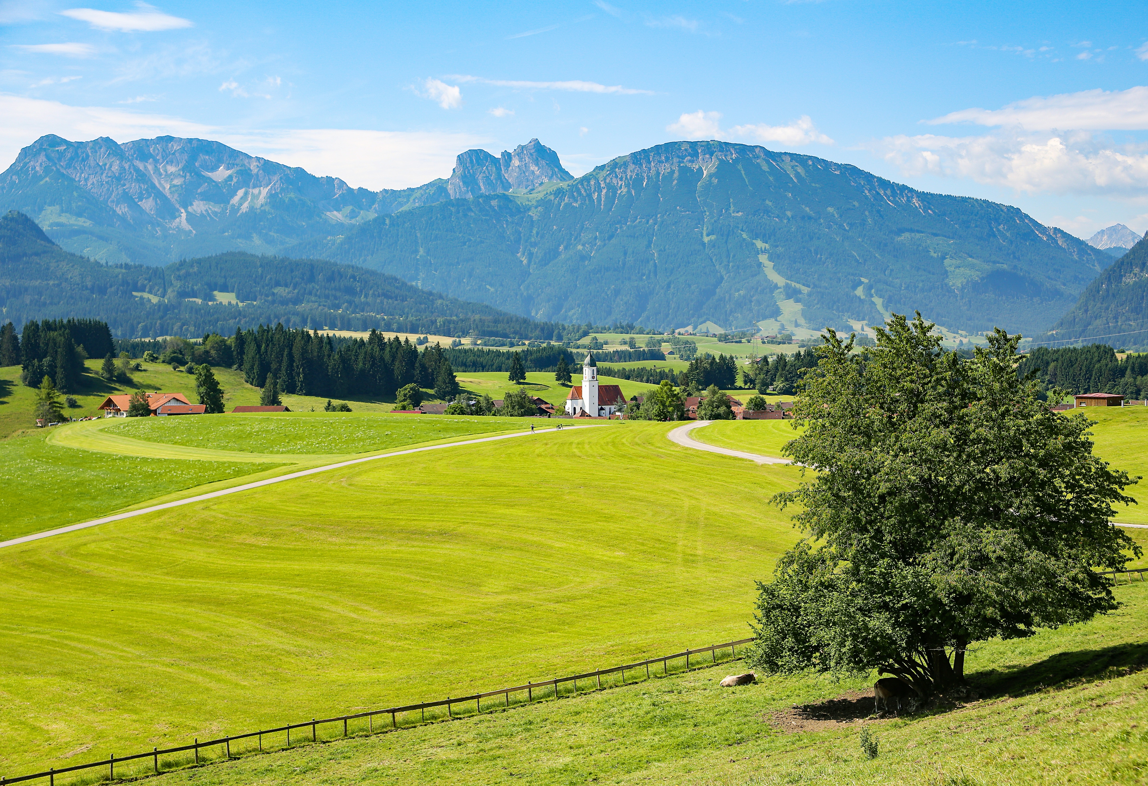
Summary
Smart Villages are the need of the hour as development is needed for both rural and urban areas for better livelihood and Information technology will offer effective solution. There are successful technologies available, which have been implemented in urban areas. ICT/ IT and GIS are the unbreakable pillars to support the whole process of village development. Each village is a unique example and having diverse set ofproblems and situations.It may be difficult to implement the same model of village development for all the villages. To address this complex problem, Public Private Partnership (PPP) may play key role for developing smart villages. Benefits of the smart village efforts are foreseen to be tremendous. Smart village concept is having high replication potential in other countries of developing world. The concept of smart village may also be extended to small towns and also townships surrounding the big Cities.
“India lives in its villages” – Mahatma Gandhi

Slide 20
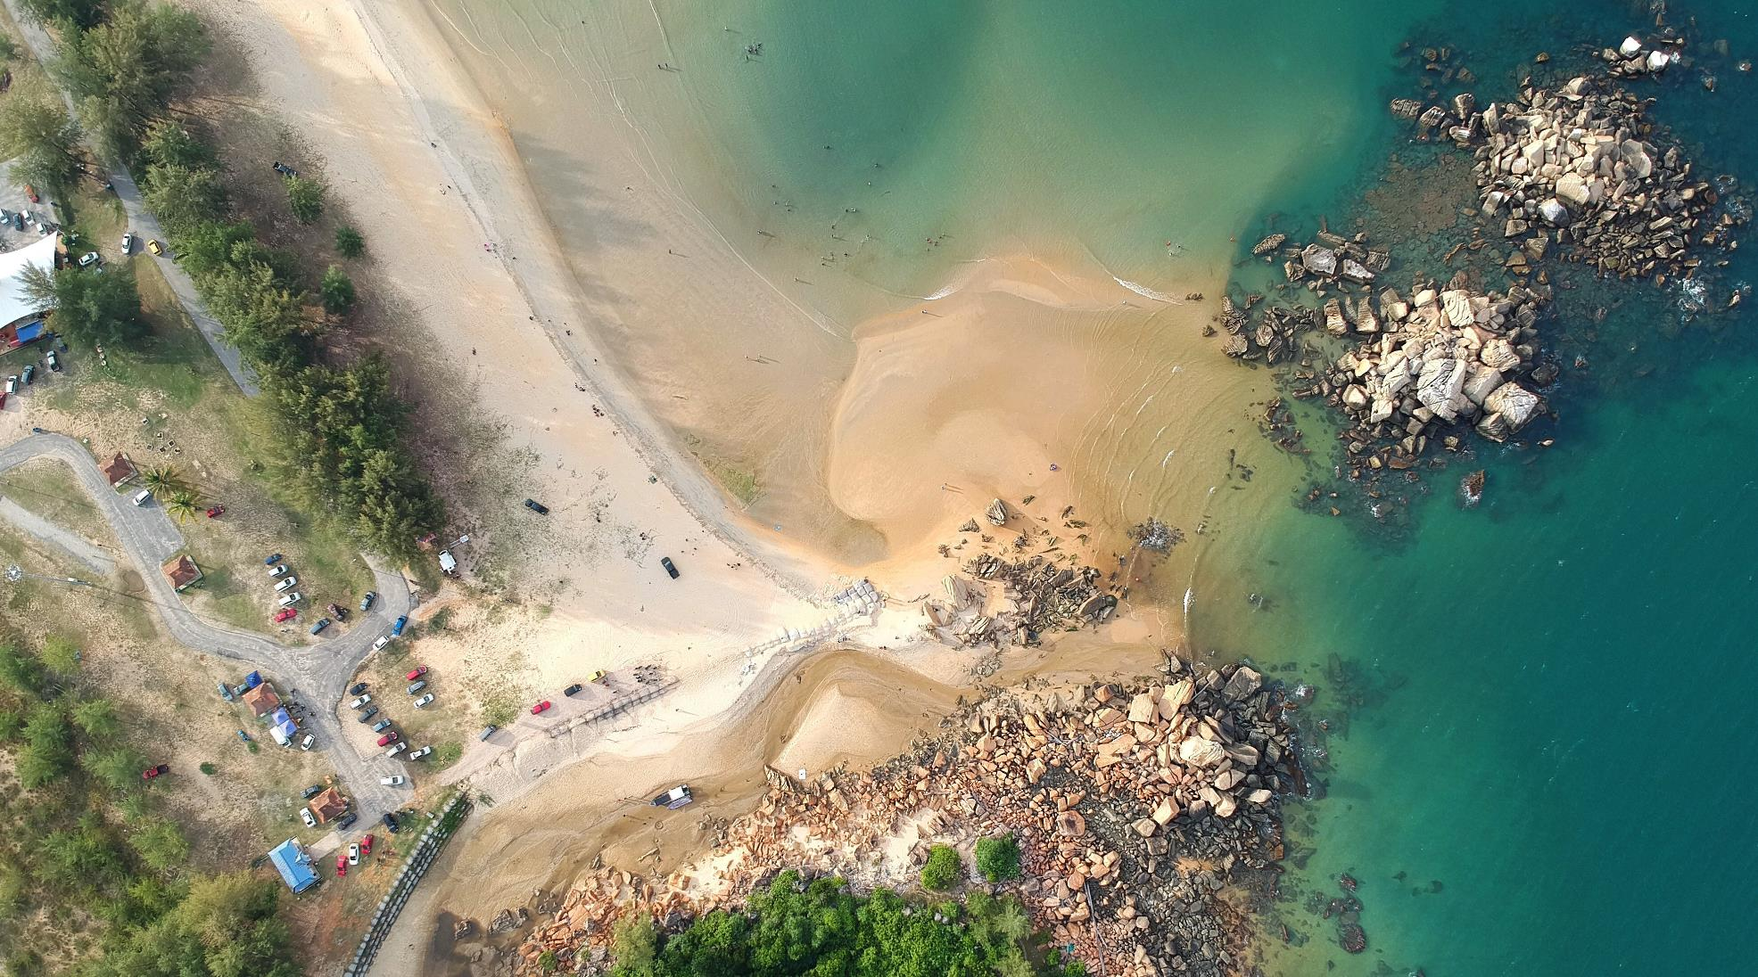
Thank You
Credits
Research & Analysis – Sambit
Report & Review – Debatanya
Presentation & Graphics - Satyabrat

